Slide 1
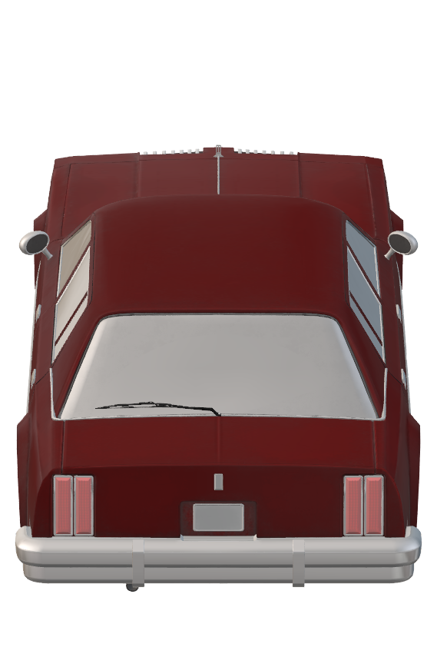
AUTOMATED
TOLL
MANAGEMENT
SYSTEM
BE PROJECT
- Divya Bhosle ( 08 )
- Sumit Jha ( 22 )
- Sai Narayan ( 45 )
- Nimritee Sirsalewala ( 63 )

Slide 2
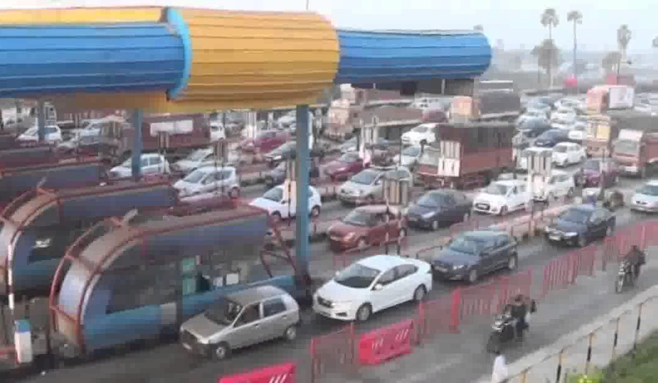
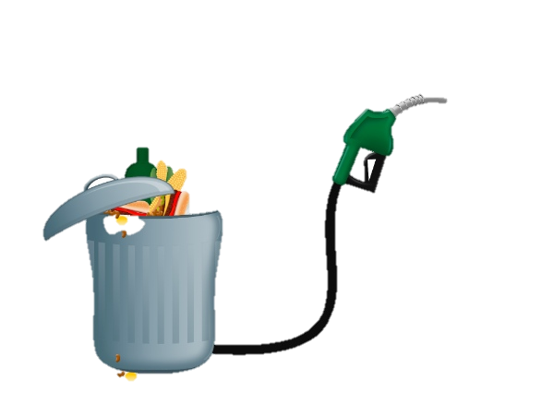
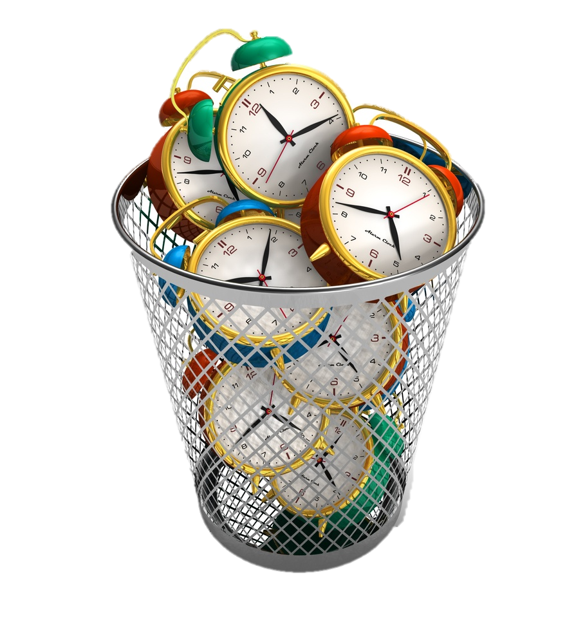

Slide 3
FUEL WASTAGE
₹ 27,000 Crores!!
+
₹ 60,000 Crores!!

Slide 4
CORRUPTION
₹ 5,000 Crores!!
₹ 10,000 Crores!!

Slide 5
Abstract
Allows vehicles to pass automatically
Records vehicle details that pass through
Report Generation

Slide 6
Problem Definition
Wastage
Time
Fuel
Money
Eliminates these problems by automating the process
Formation of an LPR system with a combination of high
Speed cameras and RFID Sensors

Slide 7
Scope
To make an efficient, fully functioning, Automated Toll Management System
Aid the users with the registration process
Create a Transaction / Lane Management Module that logs all activities in a toll lane
Generation of Reports

Slide 8
Review of Literature
1) Terminologies in Toll Collection Systems:
ETC ( Electronic Toll Collection )
FASTag
Pay By Phone
2) RFID

Slide 9
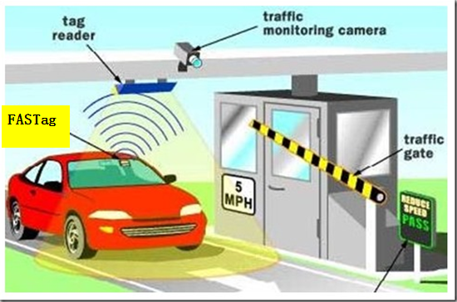
ETC
Capable of electronically charging a toll to an established customer account
The system can determine whether a passing car is registered
It automatically charges registered vehicles
Alerts Local Highway Patrol about unregistered vehicles.
NOTE: Users will still have to stop, since the need for barricades still exists

Slide 10
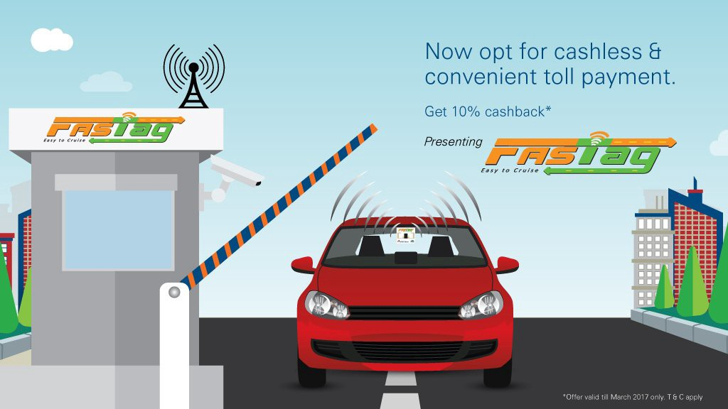
FASTag
It is used in the implementation of ETC
Uses RFID Technology
Saves Fuel and Time
Linked to bank account
Disadvantage: If a user without a FASTag enters
the lane, it’ll create a commotion.

Slide 11
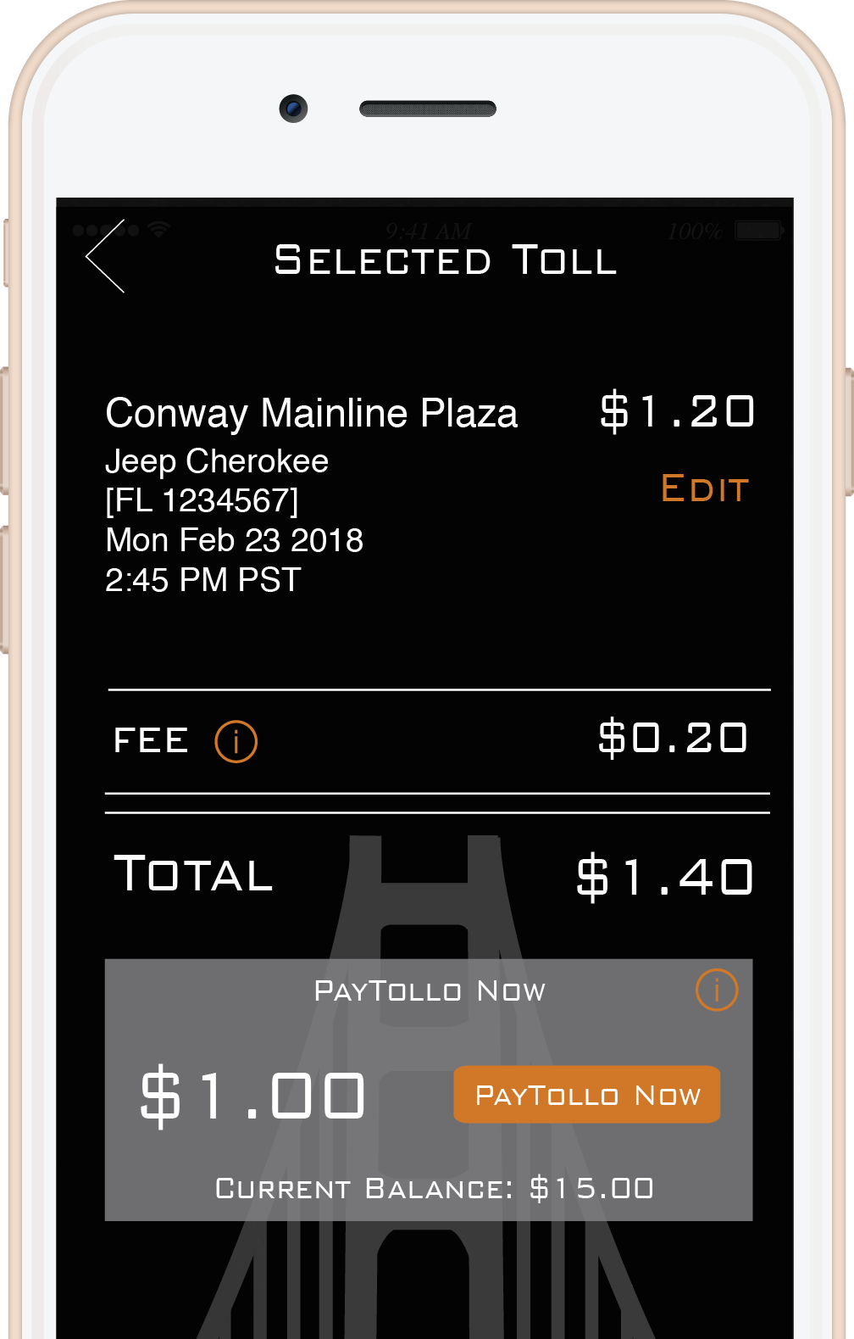
Pay By Phone
Payment done by a mobile application
Eliminates the use for manned transactions
Disadvantage: The hassle of having the application, keeping the phone on all the time

Slide 12
RFID
Carries upto 2000 bytes of data
Saves the same purpose as a barcode or the magnetic strip on credit / debit / atm cards
The RFID device must be scanned to retrieve information stored in it
With advancement in technology, RFID equipments are becoming more affordable
Data collected by RFID is accurate, and fast to scan

Slide 13
Design
Our Automates Toll Management System has 4 major components:
Customer Service Portal
Ticket Generation / Lane Management
Report Generation

Slide 14
Theoretical Implementation
Hardware Requirements:
Primary and Backup Processing Units
RFID Scanners
High Speed Cameras

Slide 15
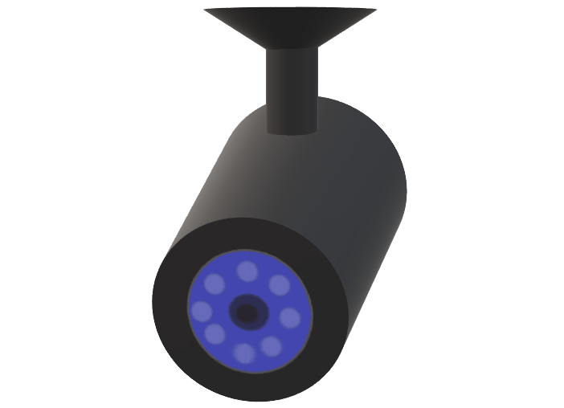
MH 12 DE 1433
MH 12 DE 1433

Slide 16
MH 12 DE 1433

Slide 17
OUR IMPLEMENTATION
1. REGISTRATION
1.1) ADD VEHICLE DETAILS
1.2) ADD USER DETAILS
1.3) WRITING DATA ON RFID TAGS

Slide 18
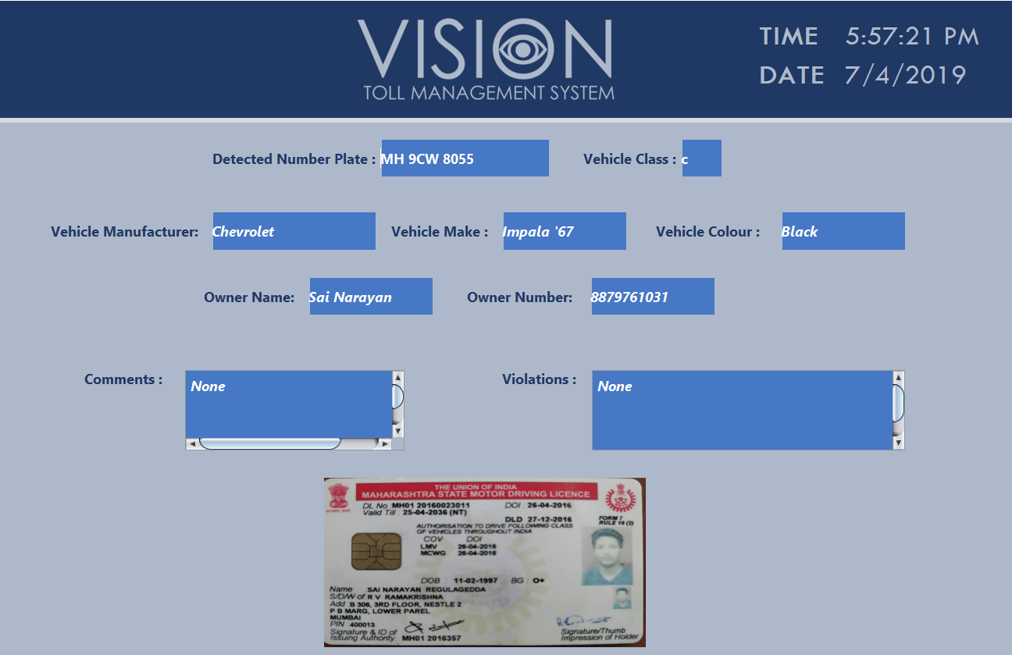
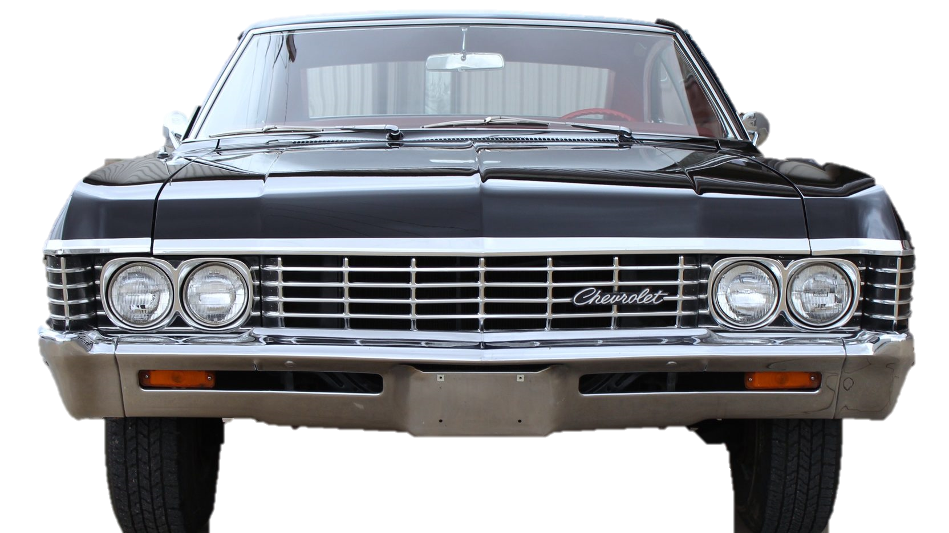
OUR IMPLEMENTATION
2. LANE MANAGEMENT
1.1) CAMERA MODULE
1.2) NUMBER PLATE DETECTION
(REAL-TIME)
1.3) OCR MODULE
1.4) NETWORK ADAPTER
(TRANSFER OF OCR DATA TO DESKTOP APPLICATION THROUGH IP)
MH 9CW 8055
1.5)TRANSFER OF LANE DATA TO LOCAL SERVER

Slide 19
OUR IMPLEMENTATION
3. REPORT GENERATION

Slide 20
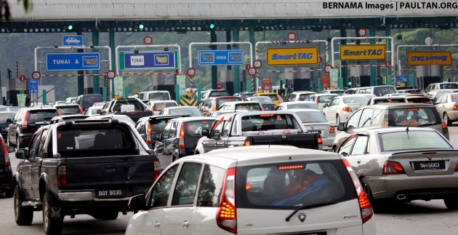
Comparison
Conventional System:
Manual Operation at toll booth
Causing traffic, fuel wastage, and loss of time
Yearly total time taken = 1500x12 = 18000seconds = 5.0 hours.

Slide 21
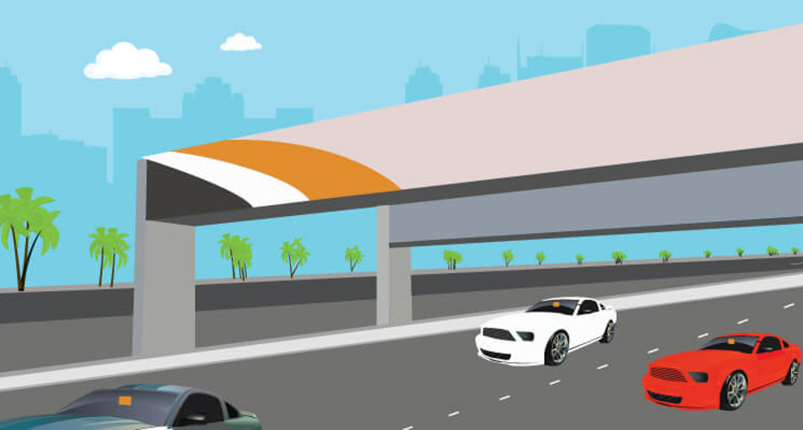
Comparison
Automated Toll Management System:
• Saves Fuel and Time
• SMS alerts for transactions
• Online recharge
• No need to carry cash
• Web portal for customers
• Safeguard feature created in case stolen cars pass through the toll
• No hassle of losing toll receipts

Slide 22
Thank You!!
A Project By:
Divya Bhosle ( 08 )
Sumit Jha( 22 )
Sai Narayan( 45 )
Nimritee Sirsalewala ( 63 )

